Slide 1
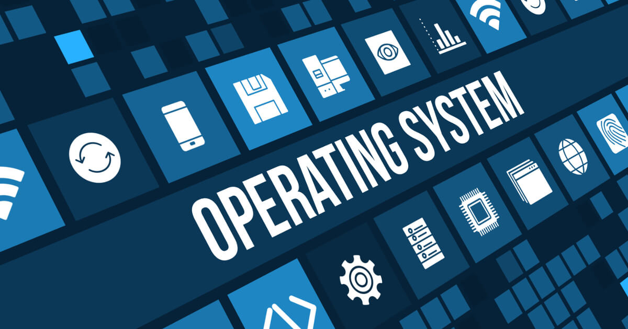
15045 WASEEM SAJJAD
75025 M. SADEEQ
2837 UMAIR FARID

Slide 2
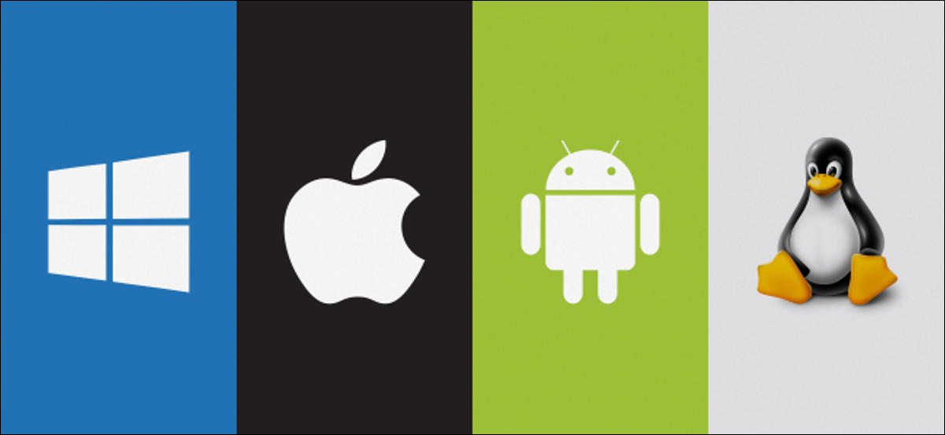
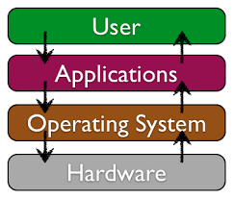
WHAT IS OPERATING SYSTEM?
Operating System is defined as a collection of programs that coordinates the operations of computer hardware and software. It acts as a bridge for the interface between man and machine.
WHY DO WE NEED OPERATING SYSTEMS?
Allow you to communicate with Computer
Booting
Managing the input/output devices
Multitasking
The platform for other application software
Manages the memory
Manages the system files
Provides Security

Slide 3
TYPES OF OPERATING SYSTEM
Real-time operating system
Fast but relatively small
Usually embedded onto a system
Designed for real time applications
Must respond quickly (in fraction of second)
Used in various fields
Medical diagnostics
Industrial systems
Aircrafts
Robotics
Single user/Multitasking OS
User performs many tasks at once
Most common form of OS
E.g. Windows, MAC OS
Require expensive computers
Tend to be complex
Support for multitasking
Instant switch between programs
Single user/Single tasking OS
One user works on the system
Performs one task at a time
MS-DOS and Palm OS
Take up little space on disk
Runs on inexpensive computers
Multi user/Multitasking OS
Many users connect to one computer
Each user has a unique session
UNIX, Linux, and VMS
Maintenance can be easy
Requires a powerful computer

Slide 4
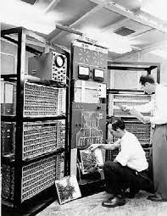
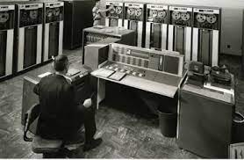
ADVANCEMENT IN OPERATING SYSTEMS
The First Generation (1940's to early1950’s)
Electronic computers where first introduced in the 1940's they were created without any operating systems.
All programming was done in machine language
This generation computers were generally used to solve simple math calculations, operating systems were not necessarily needed.
The Second Generation (1955-1965)
The first operating system was introduced in the early 1950's,
It was called GMOS and was created by General Motors for IBM's machine the 701
Operating systems in the 1950's were called single-stream batch processing systems
They were used by professional operators in large computer rooms.

Slide 5
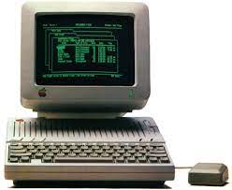
ADVANCEMENT IN OPERATING SYSTEMS
The Third Generation (1965-1980)
IBM System/360 was the first major computer to use IC “integrated circuit”
Used multiprogramming technique to save CPU time
Used timesharing system to share CPU time between users using terminal.
The Fourth Generation (1980-2022)
User type in commands from the keyboard
DOS
Graphic User Interface (GUI)
Apple with GUI
MS – Window95, 98, 2000, XP
windows 7,8,10,11

Slide 6
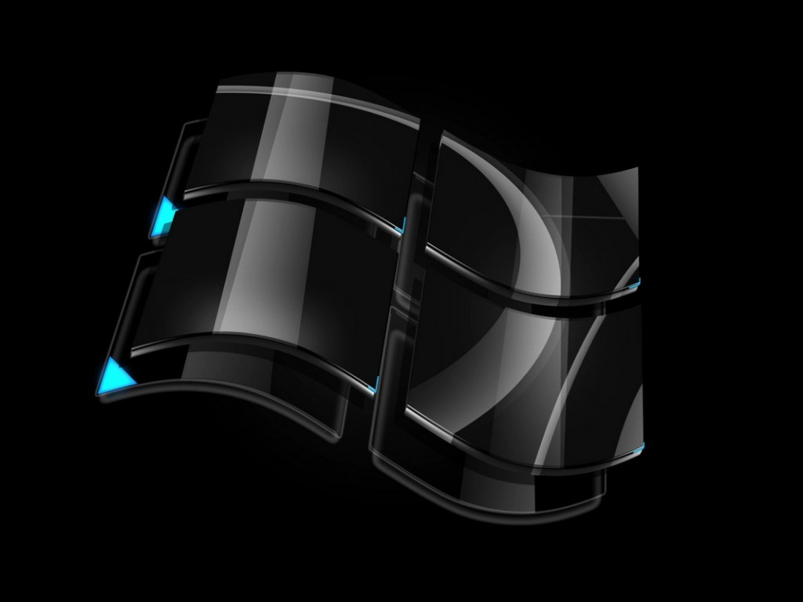
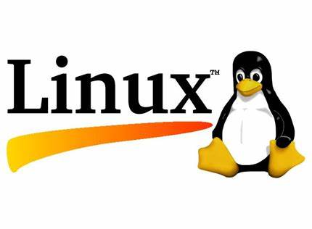
COMMON OPERATING SYSTEMS
WINDOWS
Generally referred to as the Microsoft Windows, these OS are manufactured and developed by the tech-giant Microsoft and are the most commonly used OS for personal computers and to some extent in mobile phones or the Windows phone. Microsoft Windows is a collection of many graphics oriented operating system
LINUX
Basic communication with a Linux computer is through a command line terminal (no graphics) or “shell”. That is, the commands are typed on the keyboard instead of clicking on things on the screen with a mouse.

Slide 7

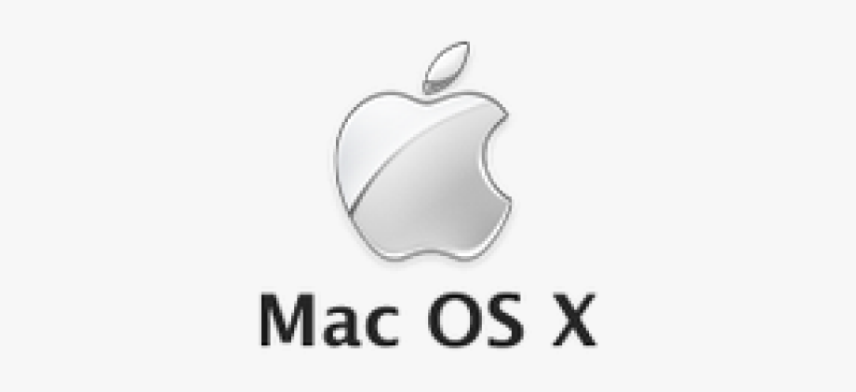
COMMON OPERATING SYSTEMS
UNIX
Unix ( trademarked as UNIX) is a family of multitasking, multiuser computer operating systems that derive from the original AT&T Unix, whose development started in 1969 at the Bell Labs research center by Ken Thompson, Dennis Ritchie, and others.
MAC OS
The term Mac OS stands for Macintosh Operating System. It’s a UNIX based operating system by Apple, exclusively for MacBooks and iMacs.
In the market of Desktops, Laptops, and Home Computers it’s the second most widely used desktop OS after Windows.

Slide 8
CONCLUSION
Operating system is important for a computer to function properly.
With the advancement in computers, the operating systems are also becoming more powerful day by day.
Without the operating system it is not possible for a computer to run and perform tasks.

Slide 9


